Slide 1
Content-Based Recommender Systems

Slide 2
UNIT II: Basic Components of Content-Based Systems, Pre-processing and Feature Extraction, Learning User Profiles and Filtering, Nearest Neighbor Classification.

Slide 3
Introduction
Comparison with Collaborative Systems:
Collaborative systems use correlations in user ratings, while content-based systems rely on item attributes and user preferences.
Content-based systems do not require other users' ratings, making them suitable for scenarios where user-specific data is sufficient.

Slide 4
Core Functionality of Content-Based Systems:
Match users to items similar to what they have liked in the past using item attributes rather than ratings correlations.
Leverage two main data sources:
Item Descriptions: Content-centric attributes, such as keywords, genre, and manufacturer.
User Profiles: Built from explicit (ratings) or implicit (actions) feedback, or specified keywords of interest.

Slide 5
Advantages of Content-Based Systems:
Effective in cold-start scenarios for items (new items with no user ratings).
Suitable for text-rich and unstructured domains, like web pages and product descriptions.
Personalized recommendations based solely on the user’s past interactions.
Disadvantages of Content-Based Systems:
Limited diversity and novelty in recommendations, as items are often too similar to past preferences.
Struggles with the cold-start problem for new users, as it requires prior user interaction data.
Recommendations may lack surprise or creativity.

Slide 6
Applications of Content-Based Systems:
Widely used in domains with text-rich data, such as:
Web page recommendations based on browsing history.
E-commerce recommendations using product descriptions and relational attributes (e.g., price, manufacturer).
Structured vs. Unstructured Representations:
Attributes can be unstructured (text-based) or structured (e.g., numerical, relational).
Both can be combined into a single structured representation for recommendation tasks.

Slide 7
Relation to Knowledge-Based Systems:
Both systems use content attributes for recommendations.
Differences:
Knowledge-based systems allow explicit specification of user requirements and interactive interfaces.
Content-based systems rely on past user behavior using learning-based approaches.
Hybrid Systems:
Combine content-based and collaborative methods to address the limitations of each approach.
Provide a unified framework for leveraging both learning-based and interactive aspects of recommendations.

Slide 8
Basic Components of Content-Based Systems
General Characteristics:
Content-based systems convert unstructured data into standardized descriptions, often keyword-based vector-space representations.
These systems largely operate in the text domain and are commonly used in applications like news recommendation systems.
Text classification and regression modeling are the primary tools for content-based recommenders.

Slide 9
Main Components of Content-Based Systems
Preprocessing and Feature Extraction:
Extract features from various sources (e.g., web pages, product descriptions, news articles).
Convert features into a keyword-based vector-space representation.
Effective feature extraction is critical and domain-specific.
Content-Based Learning of User Profiles:
Construct user-specific models based on past interactions (e.g., ratings, purchases).
Leverage explicit feedback (e.g., ratings) or implicit feedback (e.g., activity logs) to build training data.

Slide 10
Use classification (for categorical feedback) or regression (for numerical feedback) to relate user interests to item attributes.
Filtering and Recommendation:
Use the learned model to generate recommendations for users in real-time.
Efficiency is crucial since predictions need to be performed quickly.

Slide 11
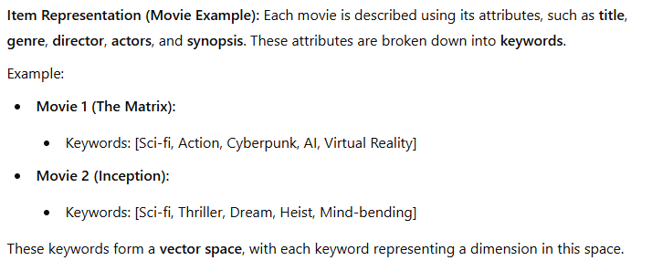
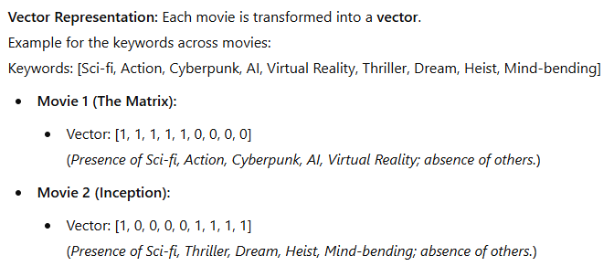

Slide 12
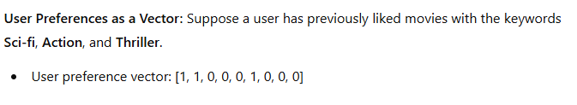
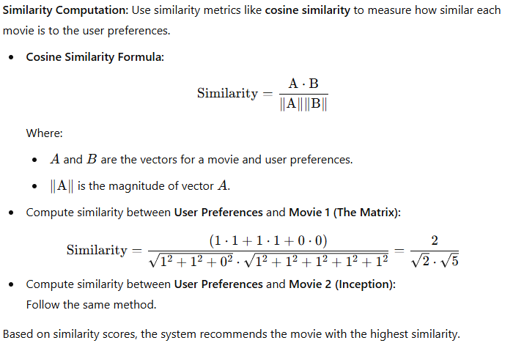


Slide 13
Model Utilization:
Classification models are commonly used in the learning phase.
Content-based systems can use these models as black-box components, focusing on how they relate user profiles to item attributes.
Additional Notes:
The learning phase is often based on well-known classification or regression techniques.

Slide 14
Preprocessing and Feature Extraction
General Overview:
The first phase in content-based systems is extracting discriminative features to represent items effectively.
Discriminative features are predictive of user interests and vary based on the application (e.g., product recommendation vs. web pages).

Slide 15
Feature Extraction:
Convert item descriptions into keywords or structured representations for processing.
Common approaches:
Bag of Keywords: Extract text descriptions and convert them into keyword-based vectors.
Structured Representation: Use numerical (e.g., price) or categorical attributes (e.g., color, genre).

Slide 16
Feature Weighting:
Assign different levels of importance to attributes.
Approaches:
Domain-Specific Knowledge: Heuristics to decide keyword weights (e.g., title and main actor in movies).
Automated Methods: Learn feature weights algorithmically (closely related to feature selection).

Slide 17
Examples of Feature Extraction in Various Applications:
Product Recommendation (e.g., IMDb):
Attributes include movie synopsis, director, actors, and genre.
Example: For the movie Shrek, attributes like "ogre," "princess," and "magical creatures" form the keyword set.
Importance of features (e.g., actors vs. synopsis) can be determined using:
Domain-Specific Knowledge: Weight features like title or primary actor higher.
Automated Methods: Use feature weighting or selection algorithms.

Slide 18
Web Page Recommendation:
Extract structured data from HTML fields like title, meta-data, and body.
Weight fields differently; for instance, title and meta-data are given higher importance than the body.
Handle irrelevant blocks (e.g., ads or disclaimers) using:
Tree-Matching Algorithms: Learn document layouts and extract main content blocks.
Classification Methods: Identify main content versus irrelevant blocks.

Slide 19
Music Recommendation (e.g., Pandora):
Features are extracted from the Music Genome Project, including attributes like:
“Trance roots,” “synth riffs,” “tonal harmonies,” “straight drum beats.”
Users create a "station" by specifying one track, and similar songs are recommended.
User feedback (likes/dislikes) refines recommendations over time.
Keywords or structured attributes (e.g., genres or beats) form the basis for recommendation.

Slide 20

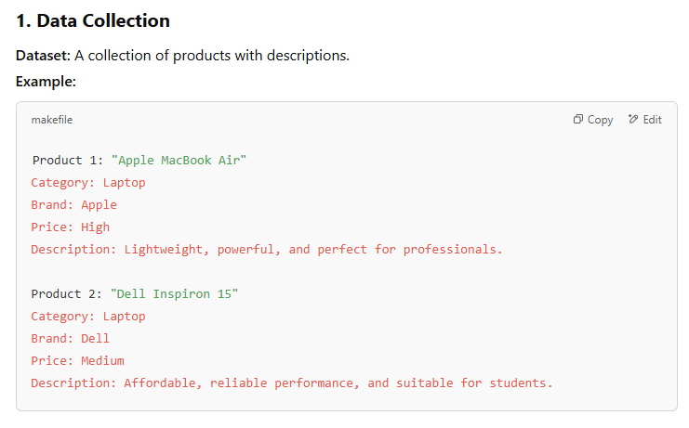

Slide 21
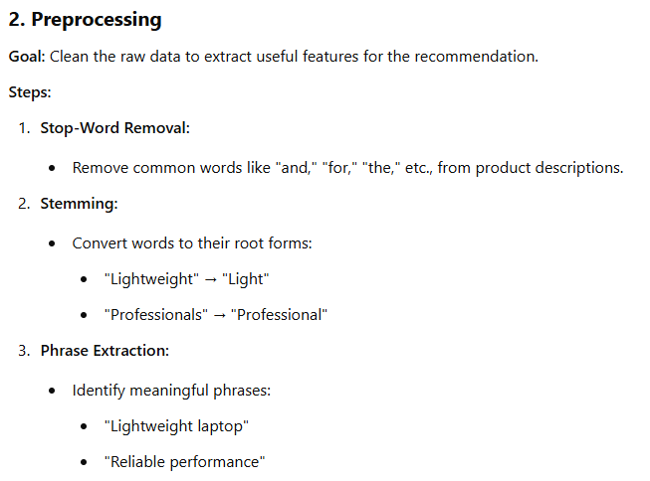
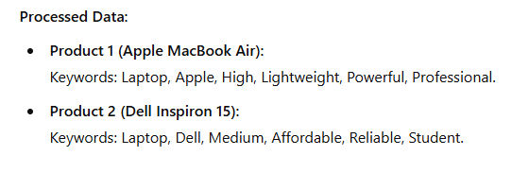

Slide 22
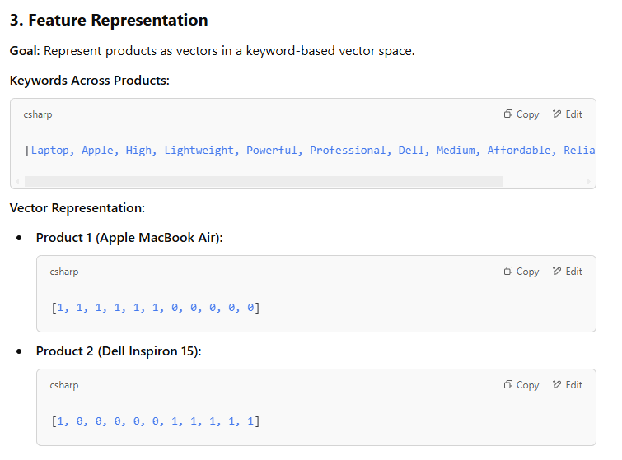

Slide 23
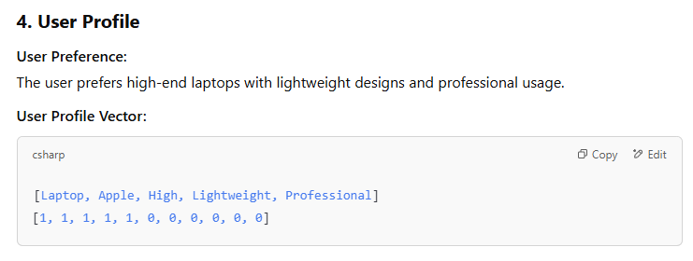
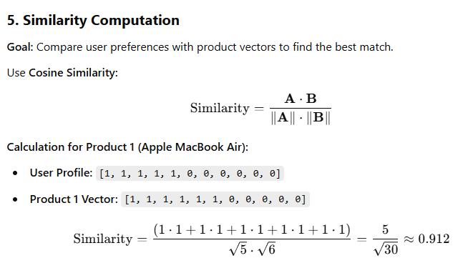

Slide 24
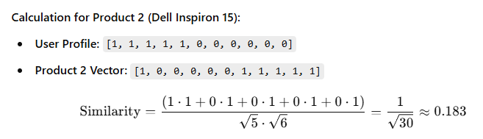
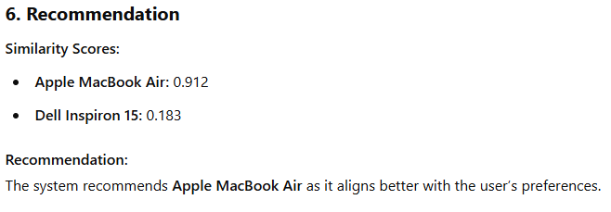

Slide 25
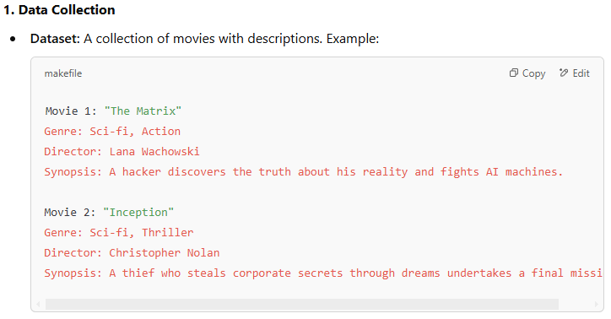

Slide 26
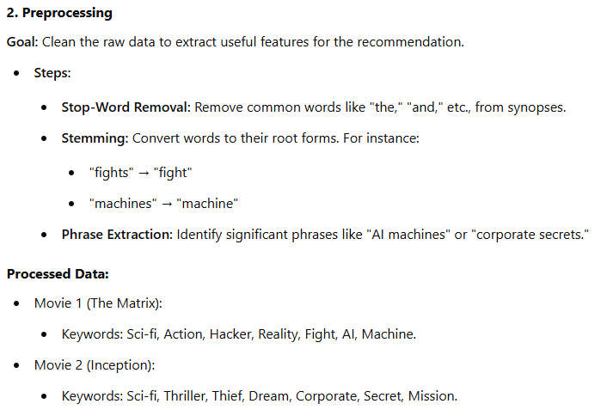

Slide 27
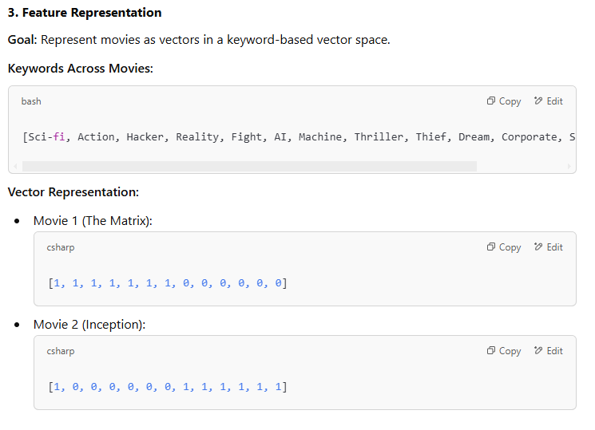

Slide 28
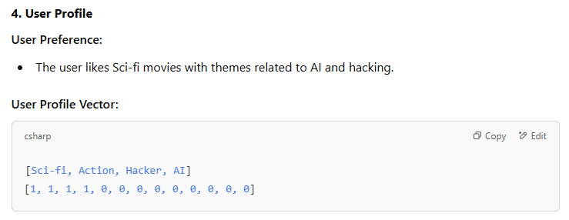
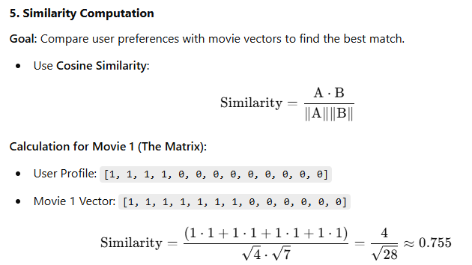

Slide 29
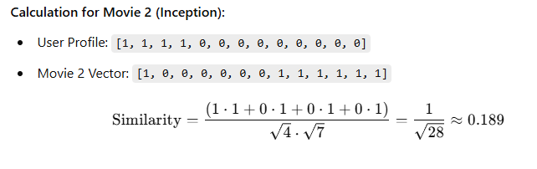
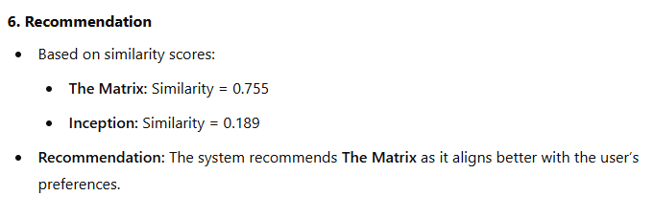

Slide 30
Key Insights:
Domain-Specific Techniques: Feature extraction and weighting are tailored to specific applications (e.g., movies vs. music vs. web pages).
Combination of Attributes: Both unstructured (text-based) and structured (numerical/categorical) attributes can be combined for robust recommendations.
Knowledge-Based Systems: In cases like Pandora, the initial track specification resembles knowledge-based systems, but user feedback transitions the approach to content-based recommendations.

Slide 31
Feature Representation and Cleaning
Importance:
Transform unstructured data (e.g., product descriptions, web pages) into a cleaned and structured format suitable for analysis.
Represent text as bags of words for further processing.
Key Steps in the Cleaning Process:
Stop-Word Removal:
Remove high-frequency, non-informative words (e.g., "a," "an," "the") that are not specific to the item.
Common stop-words include articles, prepositions, conjunctions, and pronouns.
Pre-defined stop-word lists are available for various languages.

Slide 32
Stemming:
Consolidate variations of words into their root forms.
Example: "hoping" → "hop," "machines" → "machine."
Caution: Stemming can sometimes lead to loss of meaning (e.g., "hop" as a word itself).
Phrase Extraction:
Identify significant word combinations that occur frequently.
Example: "hot dog" has a distinct meaning compared to "hot" and "dog."
Methods: Use manually defined dictionaries or automated algorithms.

Slide 33
Vector-Space Representation:
Definition:
After cleaning, text data is converted into a vector of terms, where each term is associated with its frequency.
Challenges:
Commonly occurring words are less discriminative and may bias results.
Use weighting methods to emphasize more meaningful terms.

Slide 34
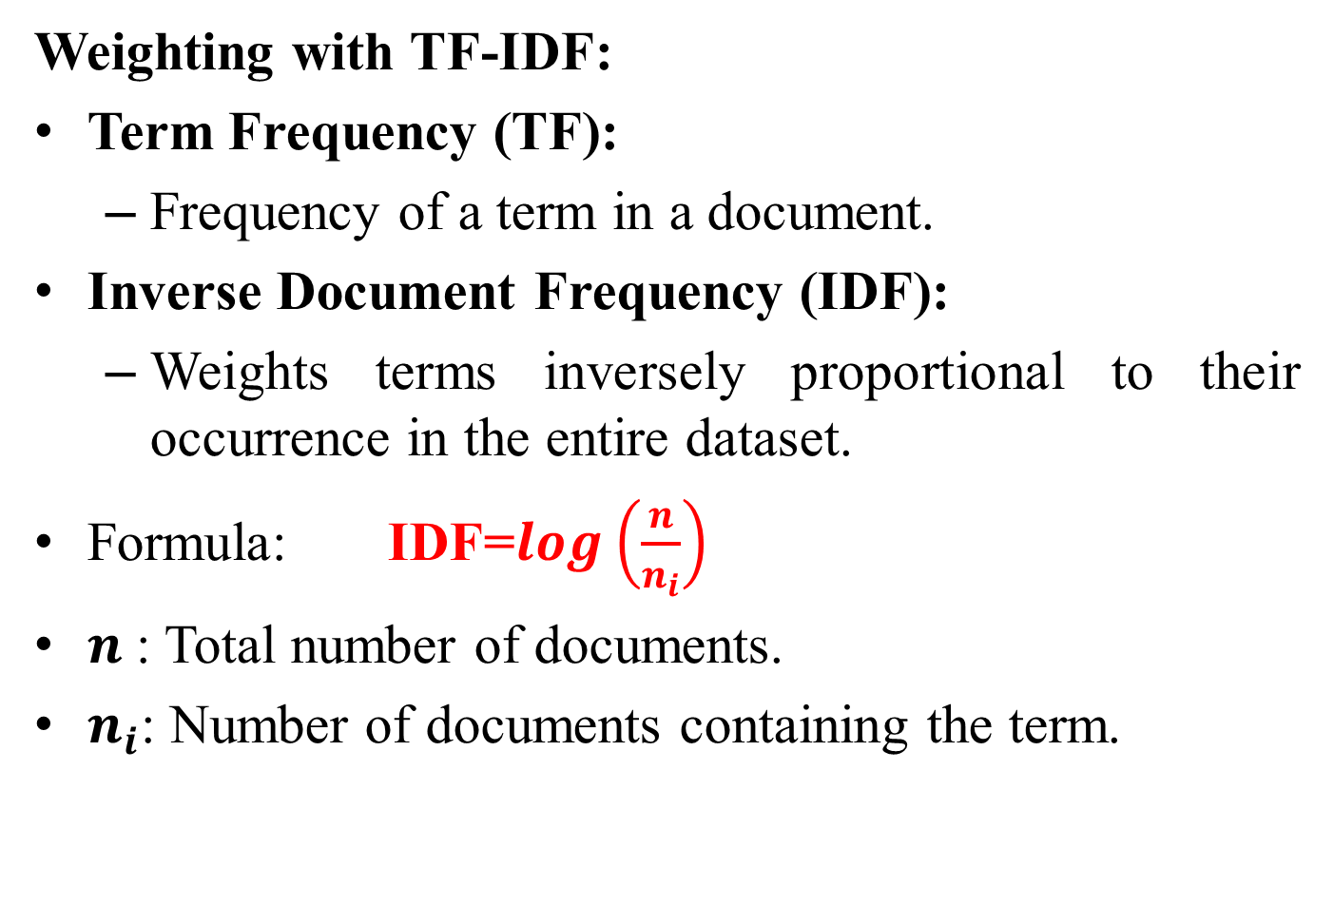
Weighting with TF-IDF:
Term Frequency (TF):
Frequency of a term in a document.
Inverse Document Frequency (IDF):
Weights terms inversely proportional to their occurrence in the entire dataset.
Formula: IDF=$\log\left(\frac{n}{n_{i}}\right)$
$n$: Total number of documents.
$n_{i}$​: Number of documents containing the term.

Slide 35
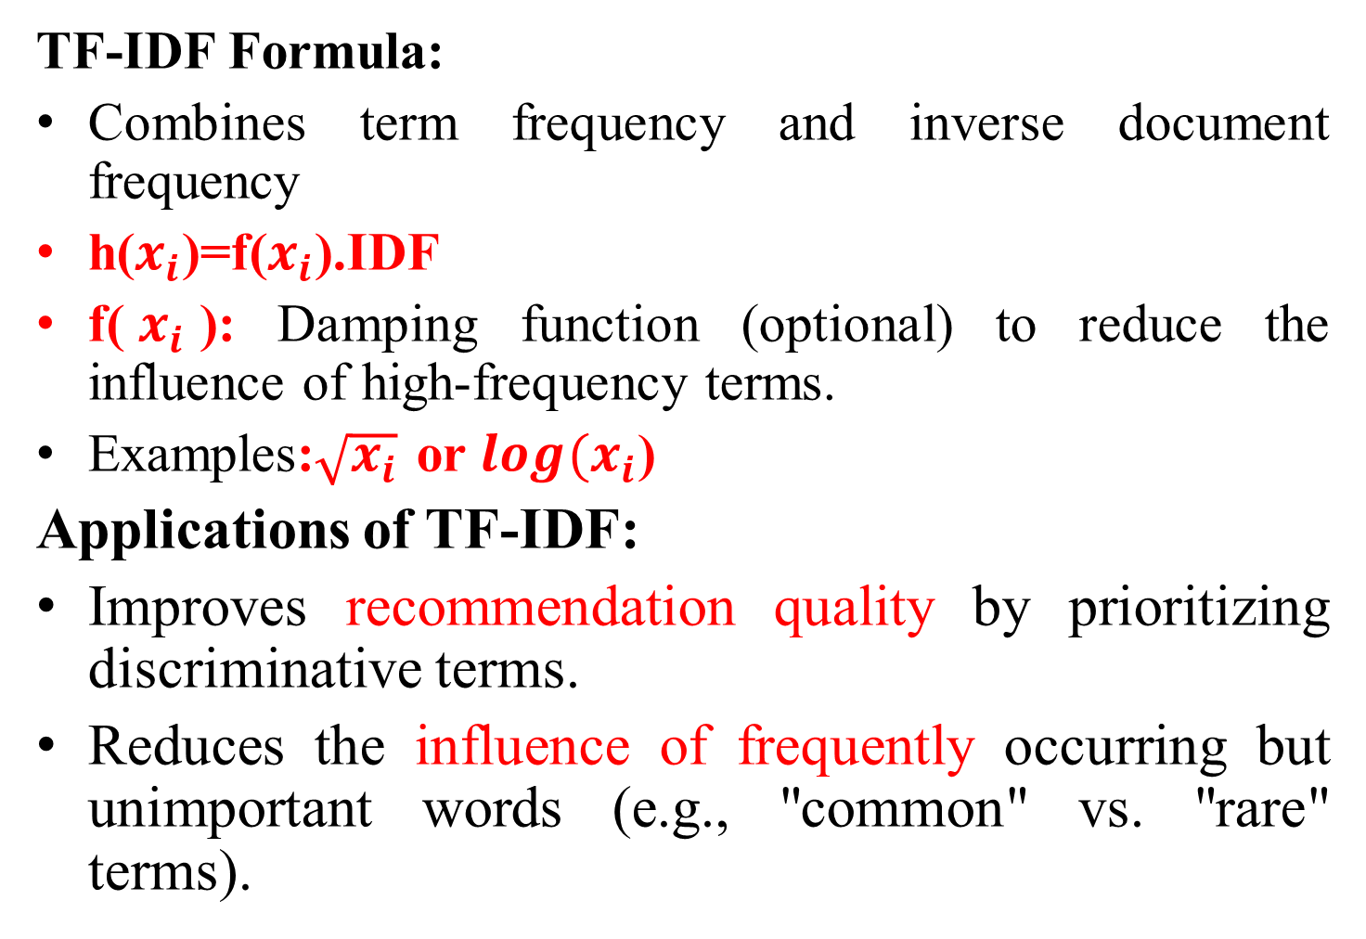
TF-IDF Formula:
Combines term frequency and inverse document frequency
h($x_{i}$)=f($x_{i}$).IDF
f($x_{i}$): Damping function (optional) to reduce the influence of high-frequency terms.
Examples:$\sqrt{x_{i}}$ or $\log{{(x}_{i}}$)
Applications of TF-IDF:
Improves recommendation quality by prioritizing discriminative terms.
Reduces the influence of frequently occurring but unimportant words (e.g., "common" vs. "rare" terms).

Slide 36
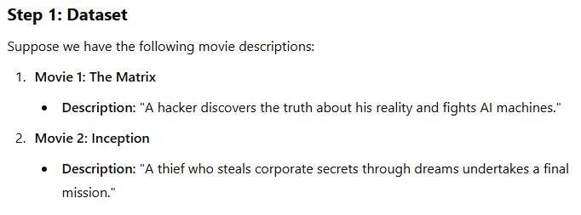
Example: Feature Representation and Cleaning with TF-IDF

Slide 37
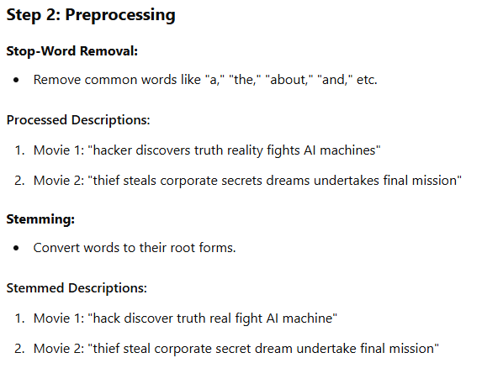

Slide 38
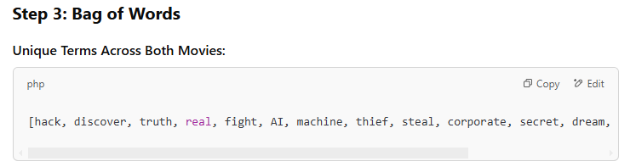
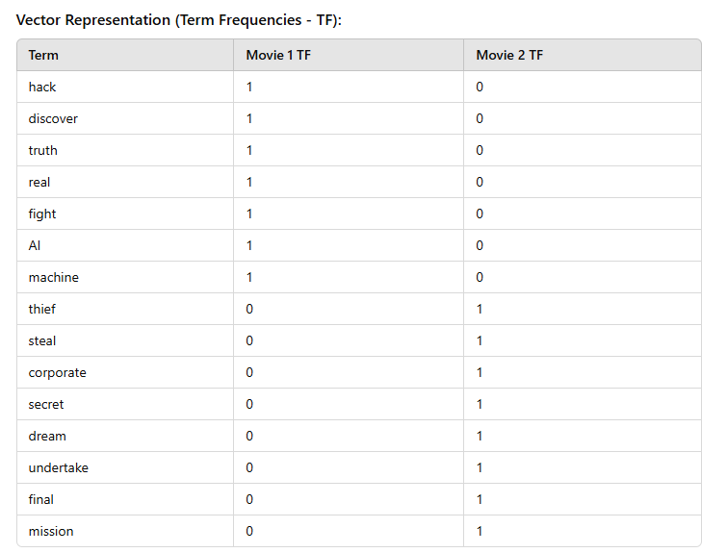

Slide 39
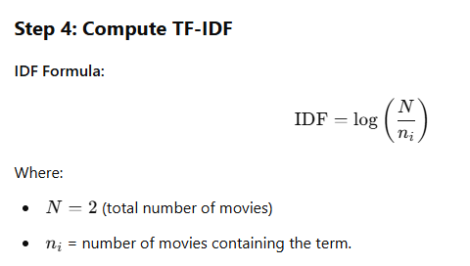
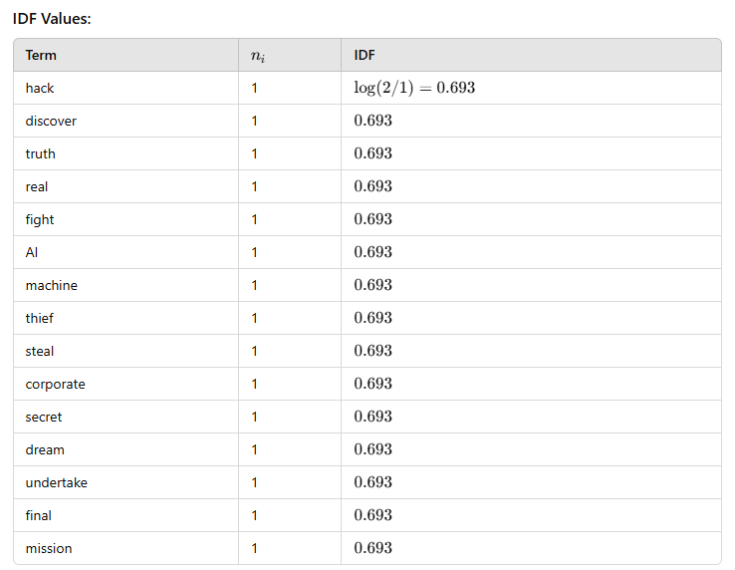

Slide 40
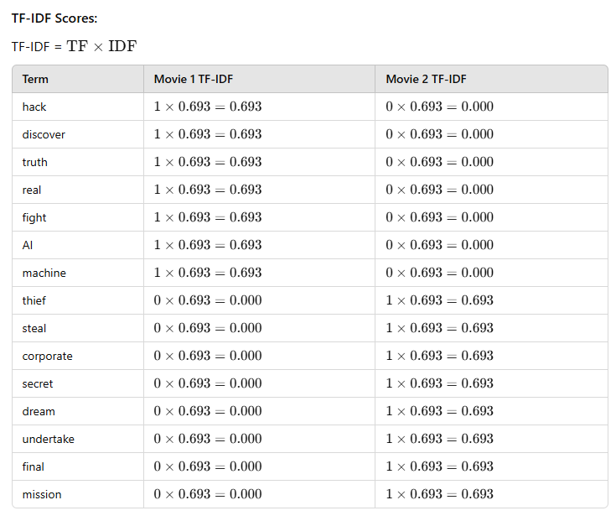
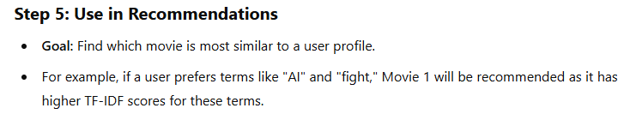

Slide 41
Collecting User Likes and Dislikes
Purpose:
Gather user preferences (likes and dislikes) during the offline phase to generate recommendations during the online phase.
Combine the user's preferences with content data to create predictions for the active user (the user interacting with the system at any given time).

Slide 42
Forms of User Feedback:
Ratings:
Users explicitly specify ratings for items.
Types of ratings:
Binary (e.g., like/dislike).
Interval-based (e.g., 1–5 stars).
Ordinal or real-valued ratings.
The type of rating influences the model used for learning user profiles.
Implicit Feedback:
Captures user actions such as:
Positive preferences: Buying, browsing, or clicking an item.
Does not typically include negative preferences.

Slide 43
Text Opinions:
Users express preferences through textual descriptions (e.g., reviews or comments).
Preferences are extracted using techniques like:
Opinion Mining.
Sentiment Analysis.
Cases:
Users specify examples or cases of items they are interested in.
These cases are used:
As implicit feedback for models like nearest neighbor or Rocchio classifiers.
In case-based recommender systems where domain knowledge is used to find matches.

Slide 44
Special Notes:
Hybrid Approaches:
Some systems blend knowledge-based and content-based approaches:
Example: Spotify:
Starts as a knowledge-based system (user specifies an initial case, such as a favorite music album).
Transitions to a content-based and collaborative system using user feedback.
Output Representation:
User feedback (likes/dislikes) is ultimately converted into:
Unary, binary, interval-based, or real ratings.
These ratings serve as a class label or dependent variable for learning purposes.

Slide 45
Supervised Feature Selection and Weighting
Objective of Feature Selection & Weighting
Ensure only informative words are retained in the vector-space representation.
Reduce the risk of overfitting by filtering out noisy features.
Improve recommendation accuracy, especially when limited data is available.
Used in recommender systems to limit keywords between 50 and 300.

Slide 46
Two Aspects of Feature Selection
Feature Selection: Removing irrelevant words.
Feature Weighting: Assigning different importance to words.
Examples of unsupervised selection methods:
Stop-word removal
Inverse Document Frequency (IDF)
Supervised selection methods:
Consider user ratings to rank features.

Slide 47
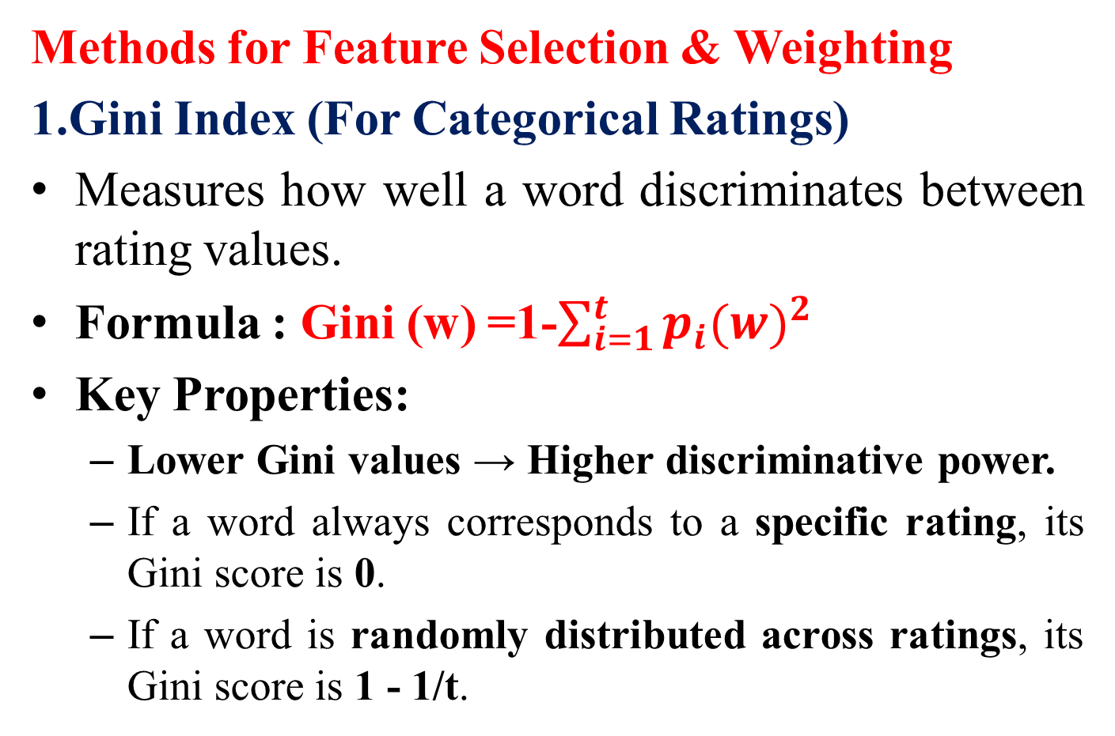
Methods for Feature Selection & Weighting
1.Gini Index (For Categorical Ratings)
Measures how well a word discriminates between rating values.
Formula : Gini (w) =1-$\sum_{i=1}^{t}{{p_{i}(w)}^{2}}$
Key Properties:
Lower Gini values → Higher discriminative power.
If a word always corresponds to a specific rating, its Gini score is 0.
If a word is randomly distributed across ratings, its Gini score is 1 - 1/t.

Slide 48
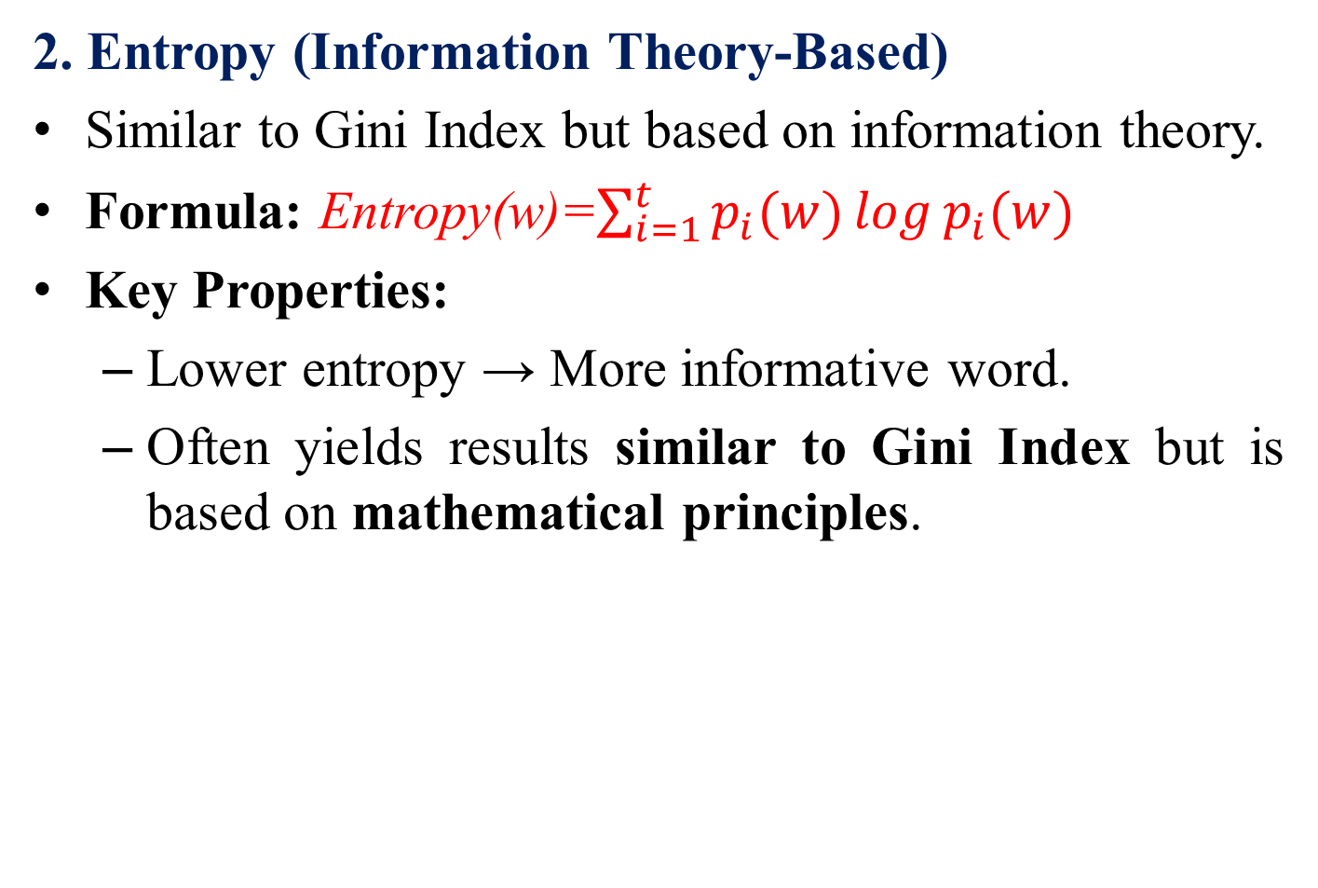
2. Entropy (Information Theory-Based)
Similar to Gini Index but based on information theory.
Formula: Entropy(w)=$\sum_{i=1}^{t}{p_{i}(w)\log{p_{i}(w)}}$
Key Properties:
Lower entropy → More informative word.
Often yields results similar to Gini Index but is based on mathematical principles.

Slide 49

3. Chi-Square (χ²) Statistic
Tests if a word is statistically significant in predicting ratings.
Compares expected vs. observed word occurrences in different rating categories.
Formula for a 2×2 contingency table:
Key Properties:
Higher χ² value → Stronger correlation between word and rating.
If expected = observed, χ² = 0 (word is irrelevant).
Only the top-k words with highest χ² scores are retained.

Slide 50
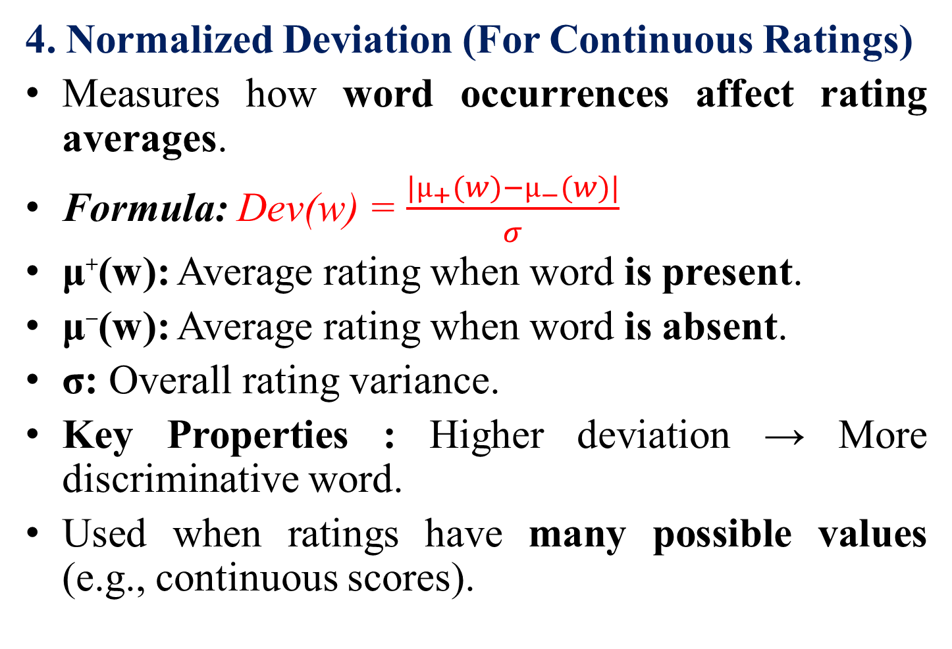
4. Normalized Deviation (For Continuous Ratings)
Measures how word occurrences affect rating averages.
Formula: Dev(w) = $\frac{{|µ}_{+}(w)−µ_{−}(w)|}{σ}$
μ⁺(w): Average rating when word is present.
μ⁻(w): Average rating when word is absent.
σ: Overall rating variance.
Key Properties : Higher deviation → More discriminative word.
Used when ratings have many possible values (e.g., continuous scores).

Slide 51
Feature Weighting (Soft Selection)
Instead of removing words, assign weights based on informativeness.
Example Weighting Formula:
g(w)=a−Gini(w)
a: Adjustable sensitivity parameter.
Smaller a → Higher sensitivity to Gini scores.
Multiplies weight with TF-IDF scores to refine recommendations.
Other weighting strategies:
Entropy-based weighting
Inverse Document Frequency (IDF)
Cross-validation to fine-tune weights.

Slide 52
Key Takeaways
Feature selection improves efficiency by removing noisy words.
Supervised methods use ratings to find the most useful words.
Different selection techniques apply based on data type (categorical vs. continuous ratings).
Feature weighting fine-tunes importance without hard removal.
Hybrid approaches (Selection + Weighting) yield the best recommendation performance.

Slide 53
Learning User Profiles and Filtering
User Profiles and Recommendation Learning:
User profile learning is similar to classification and regression modeling.
Ratings can be discrete (e.g., “thumbs up” or “thumbs down”) → Similar to text classification.
Ratings can be numerical → Similar to regression modeling.
Structured vs. Unstructured Learning:
Learning methods can be applied to both structured and unstructured data.
In this discussion, text-based item descriptions are assumed.

Slide 54
Training Dataset (DL) and Active User:
DL (Labeled Training Documents):
Contains item descriptions and ratings assigned by a specific active user.
These ratings form the user profile.
No collaborative filtering → Ratings from other users are not considered.
This approach builds personalized models instead of a global one.

Slide 55
Testing Dataset (DU) for Recommendations:
DU (Unlabeled Test Documents):
Contains item descriptions for potential recommendations.
These items have not been rated by the user yet.
DU varies based on domain, e.g.:
News recommendation → DU contains candidate news articles.
E-commerce → DU contains potential product suggestions.

Slide 56
Recommendation Process Using the Model:
Training model (from DL) is applied to DU.
The system provides:
Predicted ratings for DU items.
Ranked top-k recommendations.
Comparison with Collaborative Filtering:
Unlike collaborative filtering (e.g., matrix factorization):
Each user has a separate model.
No cross-user data sharing.
This ensures personalized recommendations without requiring other users' preferences.

Slide 57
Relation to Text Classification & Regression:
Problem structure is similar to classification and regression modeling in NLP.
Models used for classification can be adapted to recommendation systems.

Slide 58

Nearest Neighbor Classification
Definition and Similarity Function:
Nearest neighbor classifier is a simple and effective classification technique.
Uses a similarity function to compare documents.
Cosine similarity is the most common measure in text-based classification:
Other similarity measures: Euclidean distance, Manhattan distance for structured data.

Slide 59
Prediction Process:
For each document in DU (test set):
Find k-nearest neighbors from DL (training set) using cosine similarity.
Compute the average rating of the k-nearest neighbors.
Assign this average rating to the document in DU.
Categorical Ratings: Uses a majority vote from the k-nearest neighbors.

Slide 60
Challenges: Computational Complexity:
Finding nearest neighbors is expensive
(complexity = ∣DL∣×∣DU∣)
Each document in DU requires comparisons with all documents in DL.
This makes the method computationally expensive for large datasets.

Slide 61
Optimization Using Clustering:
Solution: Reduce the number of training documents using clustering.
Steps:
Cluster DL into p groups per rating value.
Each group is represented as a single aggregated document.
Only k-nearest clusters are compared with test documents.
Speeds up classification while maintaining accuracy.

Slide 62
Special Case: Prototype-Based Approach:
All documents of a rating value are combined into a single prototype vector.
Instead of finding k-nearest neighbors:
The closest prototype is selected.
The rating of the prototype is assigned to the test document.
Related to Rocchio Classification, which incorporates relevance feedback.

Slide 63
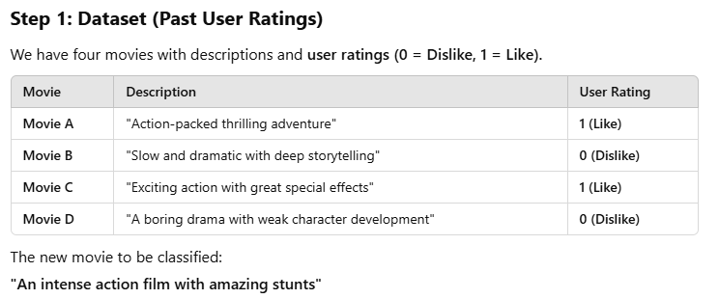

Slide 64
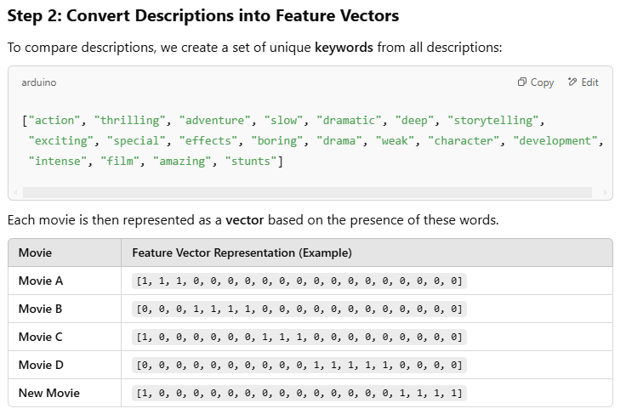

Slide 65
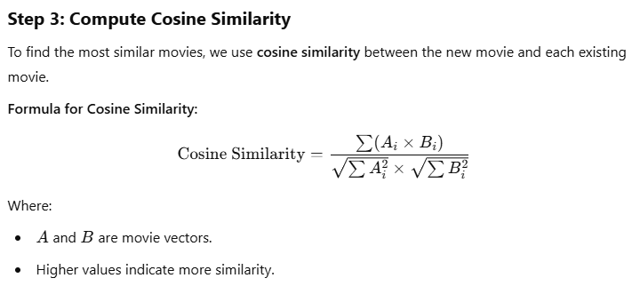
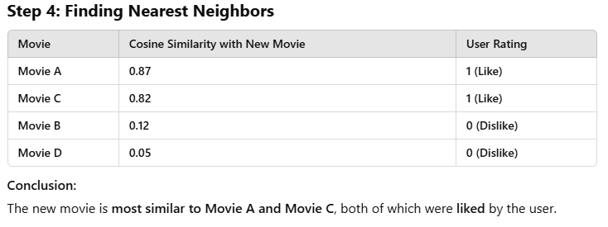

Slide 66
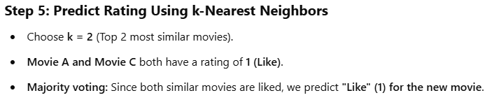
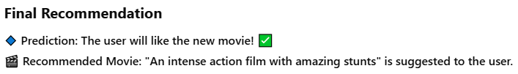

Slide 67
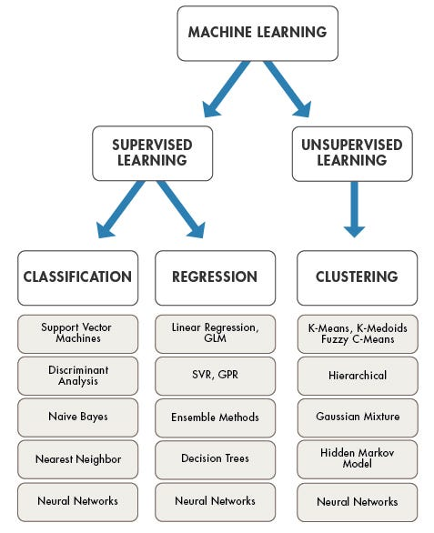
Algorithm | Regression, Classification
Linear Regression | Regression
Logistic Regression | Classification
Decision Trees | Both
Random Forests | Both
SVM | Both
KNN | Both
Gradient Boosting | Both
Naive Bayes | Classification

